Slide 1
Employee Attrition Rate

Slide 2
What’s important about Employee Attrition?
With the prevalence of remote work it is easy for employees to change companies. There are many hidden costs of hiring a new employee, which makes turnover very expensive for all companies.
Based on data collected by Human Resources, are we able to predict the factors that cause an employee to leave the company?

Slide 3
Data and Technologies
Data Source: IBM Human Resources data collected across the company
https://github.com/IBM/employee-attrition-aif360/blob/master/data/emp_attrition.csv
Technologies used:
Jupyter Notebook
Pandas
Python
Tableau
PostgreSQL

Slide 4
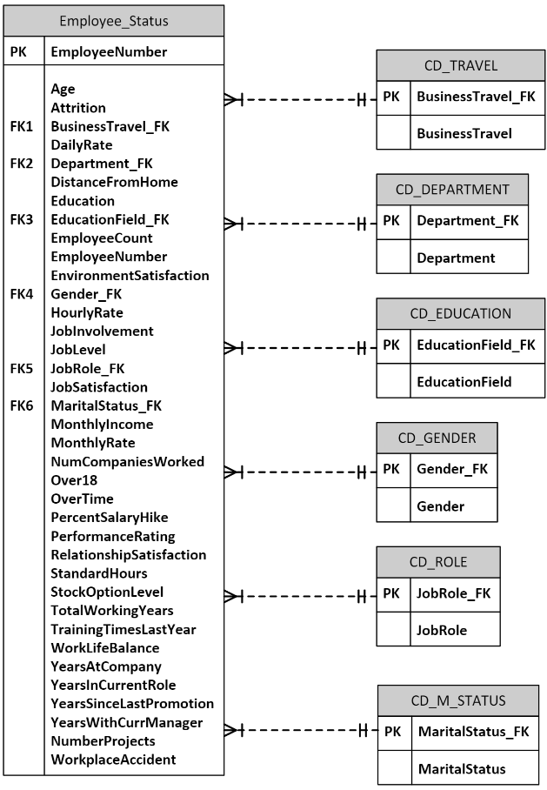
Entity Relational Diagram

Slide 5
Data Exploration
Clean data
Check columns/nulls: 37 columns
Explore data types

Slide 6
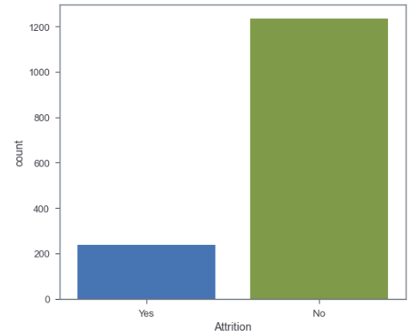
Data Exploration
Count target variable values

Slide 7
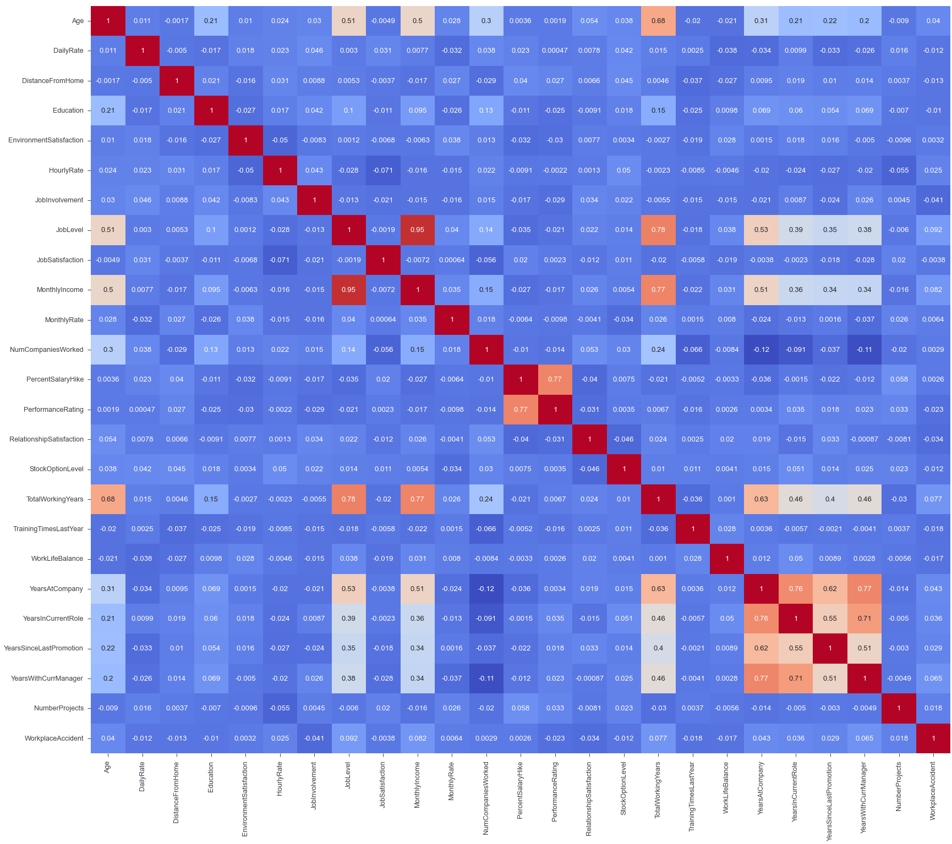
Data Exploration
Examine correlations between features

Slide 8
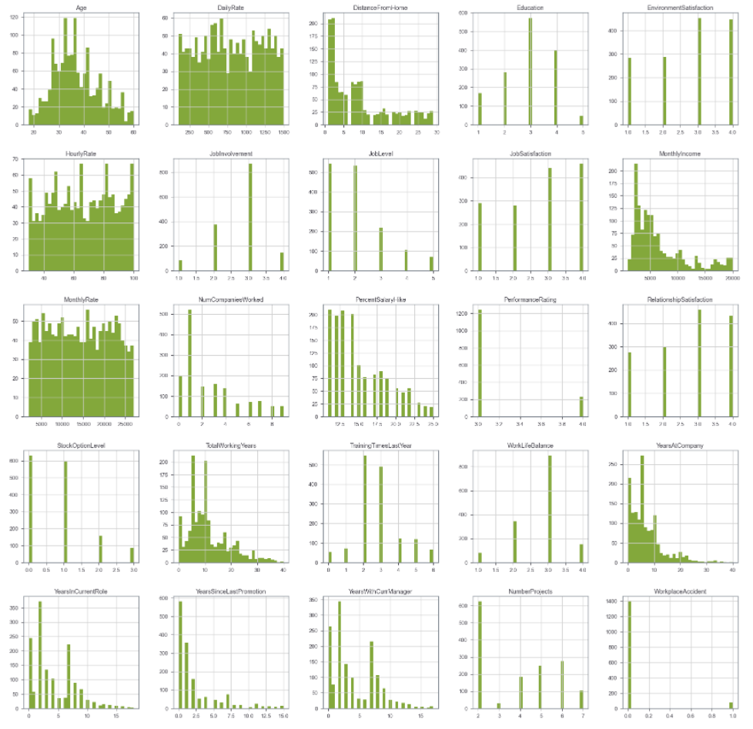
Data Exploration
Examine distribution of numerical features

Slide 9
Preliminary Feature Selection
Eliminate columns that are not useful: 4 columns dropped
ID numbers
Columns with 1 unique value

Slide 10
Data Processing
Transform categorical columns using OneHotEncoder
8 of 33 columns transformed
Split data into feature & target
Target: ‘Attrition_Yes’
Split using train_test_split
Scaling: StandardScaler

Slide 11
Data Processing
Split data shapes:
X_train (1102, 53)
X_test (368, 53)
y_train (1102,)
y_test (368,)

Slide 12
Machine Learning Models Used
Model | Accuracy Score | Tuned Accuracy Score
Logistic Regression | 87.228% | 90.816%
Random Forest Classifier | 87.772% | 87.075%
Support Vector Machine | 87.228% | 85.714%
XG Boost | 88.315% | 87.755%
Naïve Bayes | 71.467% | 70.408%
Notes:
Model
Accuracy Score
Logistic Regression
87.228%
Random Forest Classifier
87.772%
Support Vector Machine
87.228%
XG Boost
88.315%
Naïve Bayes
71.467%

Slide 13
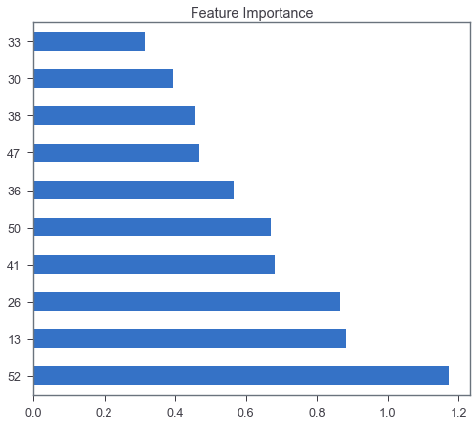
Additional Feature Selection: Feature Importance
Top 10 Features
52: OverTime_Yes
13: PerformanceRating
26: BusinessTravel_Travel_Frequently
41: JobRole_Laboratory Technician
50: MaritalStatus_Single
36: EducationField_Technical Degree
47: JobRole_Sales Representative
38: Gender_Male
30: Department_Sales
33: EducationField_Marketing

Slide 14
Dashboard Creation
https://github.com/lykkelig/Group6_Final_Project/tree/Erik_branch/Web

Slide 15
Visualizations
https://public.tableau.com/app/profile/erik.svoboda/viz/EmployeeAttrition_16528352408970/FinalProject?publish=yes

